Slide 1

ACE Engineering College
Ankushapur (v), Ghatkesar(M), Medchal Dist-501301
SENTIMENT ANALYSIS OF TWITTER DATA
Presented by:
Pamulaparthi Sai Nithin (23AG1A67B2)
2. Muniganam Akshitha (23AG1A67A7)
3. Godishala Venkataramana (23AG1A6787)
Gundoju Abhiram (23AG1A6790)
Bodiga Sai Charan (23AG1A6771)
Internal Guide
Mr. Peesala Ilanna
Assistant Professor

Slide 2
CONTENTS
ABSTRACT
INTRODUCTION
EXISTING SYSTEM AND ITS LIMITATIONS
LITERATURE SURVEY
PROPOSED SYSTEM AND ITS ADVANTAGES
HARDWARE REQUIREMENTS
SOFTWARE REQUIREMENTS
SYSTEM ARCHITECTURE
DESIGN (UML DIAGRAMS)
OUTPUT SCREENS
CONCLUSION
FUTURE ENHANCEMENT
REFERENCES

Slide 3
ABSTRACT
Social media platforms, particularly twitter, have become important channels for expressing public opinions on events, products, and social issues. The large volume and unstructured nature of twitter data make manual sentiment analysis difficult and inefficient. This project focuses on collecting twitter data and preprocessing it by removing noise such as special characters, stop words, urls, and irrelevant content to ensure data quality for effective analysis. The cleaned data is then transformed using text normalization, tokenization, and feature extraction techniques such as TF-IDF to convert textual information into numerical form.
Machine learning algorithms are applied to classify tweets into positive, negative, or neutral sentiment categories. The proposed system provides an automated and efficient sentiment analysis framework capable of handling large scale twitter data and identifying overall public opinion trends. This integrated approach improves sentiment classification accuracy and supports applications in market analysis, social research, and decision-making support systems.

Slide 4
INTRODUCTION
Sentiment Analysis is a Natural Language Processing (NLP) technique used to identify and classify opinions or emotions expressed in text.
Social media platforms like Twitter (X) generate massive amounts of real-time textual data every day.
Twitter data includes short messages (tweets) containing hashtags, emojis, slang, abbreviations, and informal language.
Due to its real-time and public nature, Twitter is a valuable source for analyzing public opinion and trends.
Sentiment analysis classifies tweets into categories such as positive, negative, or neutral.
Various techniques are used, including:
1.Machine Learning algorithms (Naïve Bayes, SVM, Logistic Regression)
2.Deep Learning models (LSTM, CNN, Transformers)
3.Lexicon-based approaches

Slide 5
EXISTING SYSTEM AND ITS LIMITATIONS
Traditional sentiment analysis systems mainly rely on text-based machine learning approaches to analyze Twitter data. These systems focus only on textual information and often ignore contextual elements such as sarcasm, emojis, and informal language.
They use preprocessing techniques such as stop word removal, tokenization, and stemming, followed by feature extraction methods like TF-IDF or Bag of Words to convert text into numerical format.
Classification is performed using algorithms such as Naive Bayes, Support Vector Machine, and Logistic Regression, which categorize tweets into positive, negative, or neutral sentiments.
However, these systems struggle with understanding contextual meaning, sarcasm, slang words, and dynamic social media expressions, leading to reduced accuracy in real-world scenarios

Slide 6
LITERATURE SURVEY
Title Name | Author Names | Technologies Used | Limitations | Year
Twitter (X) as an Electoral Barometer: Systematic Evidence from Sentiment Analysis of Twitter Data | M. Asokere, A. Wusu, O. Olabanjo | Machine Learning, NLP, Sentiment Classification | Limited validation with real election results; dataset bias | 2025
Twitter Sentiment Analysis Using Machine Learning and Deep Learning Techniques | Safa Khalid Al Sarayrah et al. | SVM, Logistic Regression, LSTM, Deep Learning | Difficulty handling sarcasm and emojis; computational cost | 2025
Sentiment Analysis: A Hybrid Approach on Twitter Data | C. G. Maurya | Hybrid ML, Opinion Mining, NLP | Complex processing pipeline | 2024
BERT Model Adoption for Sarcasm Detection on Twitter Data | T. Javed et al. | BERT Transformer Model | Sarcasm detection accuracy still limited | 2024

Slide 7
A BERT Framework for Sentiment Analysis of Tweets | A. Bello | BERT, CNN, BiLSTM | High computational resource requirement | 2023
Improving Sentiment Classification Using a RoBERTa-Based Hybrid Model | N. A. Semary et al. | RoBERTa, LSTM, CNN Hybrid | Requires large training data | 2023
Sentiment Analysis Based on User Opinions on Twitter Using Machine Learning | Jorge Cordero, José Bustillos | TF-IDF, Naïve Bayes, SVM | Limited contextual understanding | 2022
Sentiment Analysis on COVID Tweets Using COVID-Twitter Data | H. Y. Lin et al. | Deep Learning, NLP, Text Classification | Domain-specific; limited generalization | 2021

Slide 8
PROPOSED SYSTEM
The proposed system introduces an advanced and automated sentiment analysis framework designed to handle large-scale Twitter data efficiently. It improves sentiment detection by incorporating contextual understanding and modern natural language processing techniques.
The system performs enhanced preprocessing including emoji handling, slang normalization, and advanced text cleaning to improve data quality and representation.
Instead of relying only on traditional models, the proposed system utilizes deep learning approaches such as Long Short-Term Memory, Convolutional Neural Network, and transformer-based models like BERT for better contextual understanding.
As a result, the proposed system achieves higher accuracy, improved context awareness, and better handling of sarcasm, emojis, and informal social media language, making it suitable for real-time sentiment analysis applications.

Slide 9
ADVANTAGES
Real-Time Insights: Twitter provides instant public reactions to events, products, policies, and news.
Large Volume of Data: Millions of tweets are generated daily, offering a rich source of opinion data.
Cost-Effective Data Collection: Data can be collected using APIs without conducting expensive surveys.
Public Opinion Monitoring: Helps track public perception about political leaders, government decisions, and social issues.
Brand and Product Analysis: Companies can evaluate customer satisfaction and improve services based on feedback.

Slide 10
HARDWARE REQUIREMENTS
Processor: Intel Core i5 / AMD Ryzen 5 (multi-core)
RAM: 8 GB
Storage: 512 GB SSD
Network: Stable internet connection for accessing Twitter API and downloading datasets

Slide 11
SOFTWARE REQUIREMENTS
Operating System: Windows 10/11, Linux, or macOS
Programming Language: Python 3.x
Development Tool: Jupyter Notebook / VS Code / PyCharm
Libraries: NumPy, Pandas, Matplotlib, Scikit-learn

Slide 12
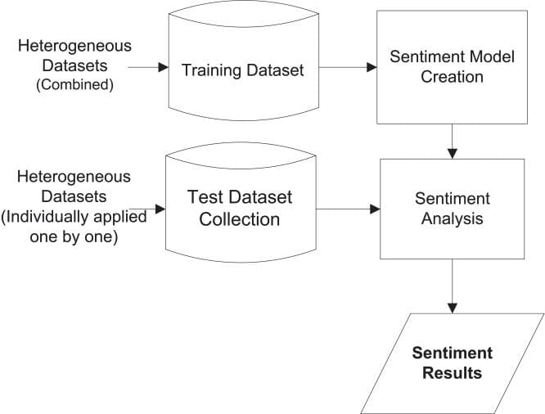
SYSTEM ARCHITECTURE

Slide 13
DESIGN (UML DIAGRAMS)
Use Case Diagram
Class Diagram
Sequence Diagram
Activity Diagram

Slide 14
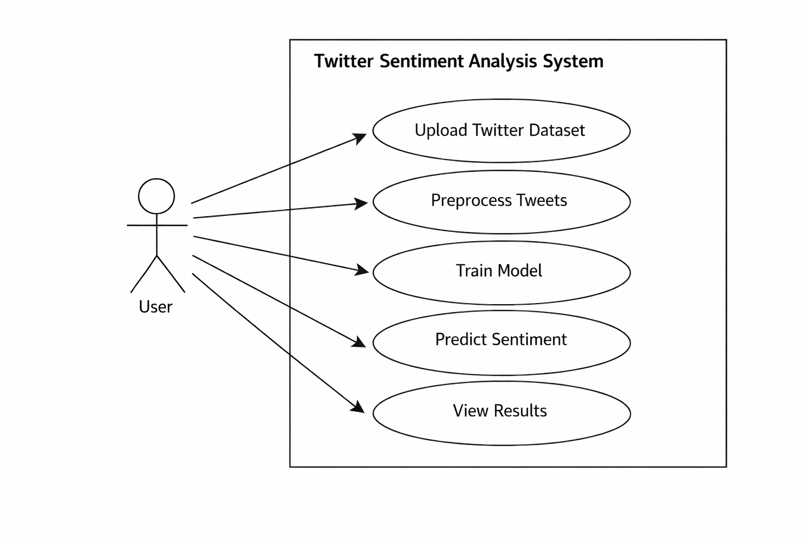
USE CASE DIAGRAM

Slide 15
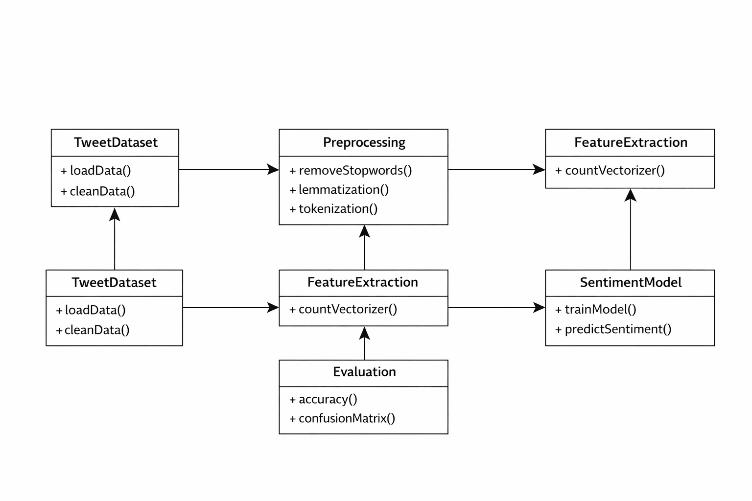
CLASS DIAGRAM

Slide 16
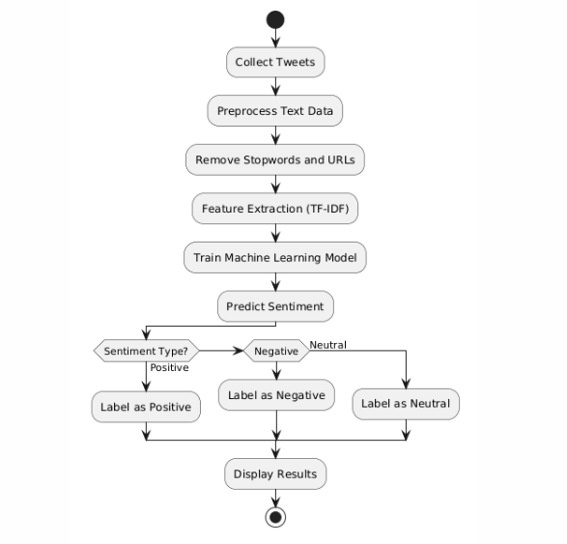
ACTIVITY DIAGRAM

Slide 17
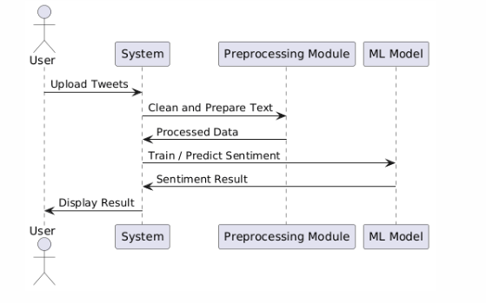
SEQUENCE DIAGRAM

Slide 18
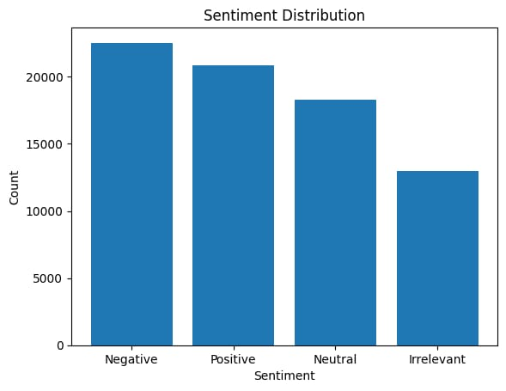
OUTPUT SCREENS

Slide 19
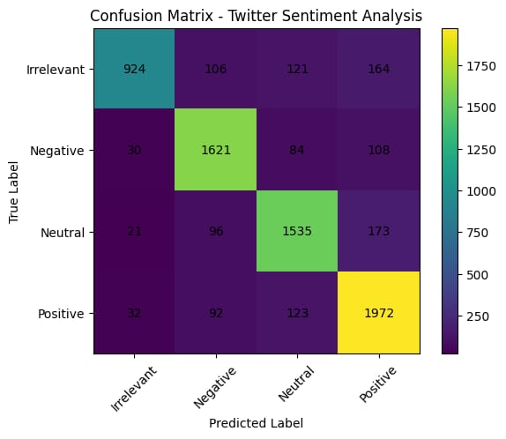
SubsetDatasetConfusion Matrix: [[ 924 106 121 164] [ 30 1621 84 108] [ 21 96 1535 173] [ 32 92 123 1972]]

Slide 20
Full Dataset Classification Report
precision recall f1-score support
Irrelevant 0.94 0.83 0.88 1315
Negative 0.92 0.92 0.92 1843
Neutral 0.88 0.91 0.89 1825
Positive 0.89 0.93 0.91 2219
Accuracy 0.90 7202
macro avg 0.91 0.90 0.90 7202
weighted avg 0.90 0.90 0.90 7202

Slide 21
CONCLUSION
The project Sentiment Analysis of Twitter Data demonstrates how social media data can be analyzed to understand public opinions and emotions. Twitter generates a huge amount of real-time textual data, making it an important source for sentiment analysis. In this project, tweets were collected and preprocessed by removing noise such as stop words, special characters, URLs, and irrelevant content to improve data quality.
After preprocessing, techniques such as tokenization and TF-IDF feature extraction were applied to convert text data into numerical form. Machine learning algorithms were then used to classify tweets into positive, negative, and neutral sentiments. The results show that automated sentiment analysis can efficiently process large volumes of Twitter data and provide valuable insights about public opinions.
Overall, the proposed system improves sentiment detection by using advanced preprocessing techniques and machine learning models. This system can be useful in areas such as market analysis, brand monitoring, social research, and decision-making by analyzing public sentiment effectively.

Slide 22
FUTURE ENHANCEMENTS
The system can be improved by using deep learning models such as LSTM, CNN, and Transformer-based models to achieve higher accuracy in sentiment classification.
Integration with real-time Twitter streaming APIs can allow continuous monitoring of live tweets and instant sentiment analysis.
The model can be enhanced to support multilingual sentiment analysis, enabling analysis of tweets written in different languages.
Advanced techniques like aspect-based sentiment analysis can be implemented to identify sentiments about specific topics or features.
Visualization dashboards can be developed to display sentiment trends, graphs, and real-time analytics for better decision-making.

Slide 23
REFERENCES
Bing Liu, Sentiment Analysis and Opinion Mining, Morgan & Claypool Publishers, 2012.
Bo Pang and Lillian Lee, “Opinion Mining and Sentiment Analysis,” Foundations and Trends in Information Retrieval, 2008.
Alec Go, Richa Bhayani, and Lei Huang, “Twitter Sentiment Classification using Distant Supervision,” Stanford University, 2009.
Jurafsky, D., & Martin, J. H., Speech and Language Processing, Pearson Education, 2019.
Basics of Python programming: https://www.python.org/
Dataset: Twitter Dataset was extracted from Kaggle.
Natural Language Toolkit: https://www.nltk.org/
Random Forest Model: https://en.wikipedia.org/wiki/Random_forest

Slide 24
THANK YOU

